Slide 1
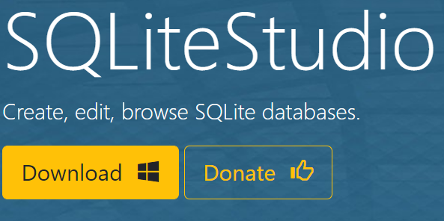
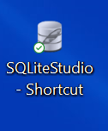
SQLiteSTUDIO set-up
STEP 3
Copy the SQLiteStudio folder to desired location (e.g. C: drive)
STEP 1
Go to SQLiteStudio
STEP 2
Click Download
STEP 5
Create a shortcut on your desktop to the application
STEP 4
Extract the File

